Slide 1
Huawei Storage Introduction Boston Storage Solution Group April 2020

Slide 2
Overview: Huawei’s Company and Storage Business
Storage Business
Product Portfolio
Key Technologies
Support Infrastructure
Customer Values
Key Messages
Huawei is a major Storage provider with broad industry acceptance
Has the resources to support and sustain the Storage business
Huawei is a leader in Storage Technology because it is Huawei
Tips
Consider the audience: C-level or tactical? Industry?
Clean the material: no small text, organized, and with a flow
Start on time! (and end on time)
Notes:
This slide is just for the training. The Key Messages are the points we want to emphasize on each slide in this section. The slides should support these Key Messages. Anything that gets in the way of making Key Messages clear should not be added to your slide deck/presentation.
Key Messages
Huawei is real, viable, capable, and worth considering. We need to give the customer the idea that Huawei is at least on the same level as EMC, HP, IBM, NetApp, Pure, or any other IT vendor they are already using.
We need to dispel any fear the customer has in choosing Huawei, including our ability to support the customers’ purchases. We also have to show that Huawei will be in business for the long-term, and will not change our commitment to this product line.
While in other parts of a presentation we need to show that Huawei is a leader in technology, here we need to show “why” Huawei can be believed as being a leader through the rest of the presentation. We can lead because we are a US$110B company with success in many other technologies, and all of the technologies and revenue drives the Storage investment, including R&D, supply chain, customer support, etc.
Tips
Throughout the training, we will hopefully provide some suggestions about how to be successful in the EU market. If you are not from the West, there may be cultural differences that, even though they seem small, will make a big difference in how the customer receives you and your information. Even if you are from the area in which you are working, some of the things we might have noticed from outside the EU might be things you have not noticed, so it is valuable for everyone to discuss the culture of the customer and make adjustments for it. I hope to provide an overall set of tips for making effective presentations later, but for now, please consider these suggestions:
Is the customer c-level, CxO? If not, they may not be too interested in this whole section, so do not spend too much time on it or you will alienate the audience. Is it the CFO at a financial customer? If so, this data better be 100% accurate and you need to be prepared to answer some detailed questions.
Every customer responds well to an organized, well-prepared meeting. How you present and your presentation is a reflection on Huawei’s quality, culture, products, and support. If the slides are complicated, the customer might worry that the product is complicated. If it is too “Chinese”, they might worry that they will not be able to understand it. However, if the slides and presentation are like precise clockwork, the audience will subconsciously view Huawei as a professional organization and focused on quality.
This also pertains to time control. Try to remember that this meeting is for them to get the data, not for you to make the sale. Be ready to start early. If someone is not there, ask if it is okay to start without them – you say something like, “because we want to be respectful of your time and have enough time to give you the information you need”. Also, end the meeting on time -- control the time. If there are a lot of questions about something, suggest that you make a separate meeting for a deep dive on that topic. More face time with the customer is good, but not if it is because you ran out of time in this meeting. Every customer responds well to ending a meeting exactly on time, and some customers will get very angry if you try to run over.

Slide 3

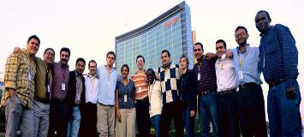


Storage Business
Product Portfolio
Key Technologies
Support Infrastructure
Customer Values
Huawei Storage Overview
18+ Years
Acquired Huawei-Symantec
in 2012
30+
Industry Organization Member
3000+
R&D Engineer
`
2000+
Storage Patent
5
R&D center
Notes:
This slide shows a common Huawei slide technique. Notice the yellow text. A contrasting color often indicates that these are the key points of this slide. Remember the Key Messages from the previous slide.
Huawei has offering Storage systems for over 18 years. (OceanStor 5000 began shipping in 2002.)
Huawei has over 3000 engineers working just on Storage R&D, including those at 5 R&D centers outside of China.
Huawei has amassed over 2000 storage-related patents, and is a member of over 30 industry standards organizations
So, this slide shows some of the Key Messages: that Huawei is a major Storage force, it is real, it the resources for support the customers, and it has invested to continue to be a Storage vendor.

Slide 4
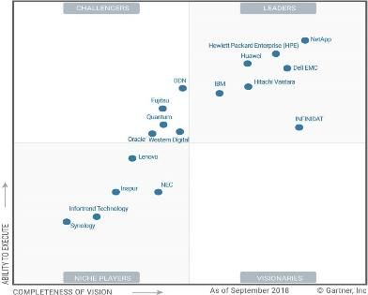
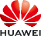








Storage Business
Product Portfolio
Key Technologies
Support Infrastructure
Customer Values
Named as“Leader” in the Gartner Storage Magic Quadrant
2018
2019
2017
2015 Top Challenger
2016 Leader
2014 Challenger
2010 Niche player
Widely used in EU Market
Company Strategy, Independent BG
Cloud & AI BG
EU Operator
Gartner Leader, Fastest Growth
Cloud BU
Intelligent Computing BU
Data Storage BU
Notes:
One way to show that Huawei is a “real” and successful Storage provider is by feedback from Industry Storage Analysts and existing customers.
Almost all customers are very familiar with key analysts. Gartner and IDC are very key influences. If Gartner reports favorably for us, we will have an advantage with the customer, so it will be useful to acknowledge their report. Part of their report is a simple 2x2 graph called the ”Magic Quadrant”. This chart places Huawei in the ”Leader” quadrant for Storage, which means that Huawei has a vision and roadmap that Gartner believes matches the needs of the customers. It also means that Huawei has shown that it will execute on its commitments and Gartner believes that we can in the future.
(click)
However, since the customer knows these charts very well, make sure that the one you are using is relevant and up to date. If not, the customer may catch that and if you are showing old data or wrong data, that reflects badly on the whole company. Unlike on this slide, it is recommended that you label charts and include citations of the source.
Customers also like to see that they are not the only ones who will be buying the product. So, reference logos are helpful. In choosing which logos to include:
Only choose relevant logos from the customer’s industry and country. If there are not enough references, then add top ones from adjacent countries. If still not enough, add a few from other top customers in the same country.
Do not add too many logos or saturate the logo display with unrelated accounts. You want the customer to focus on the ones that matter.
Make sure you know the story behind each logo that you select: what systems they are using and in what applications, whether in production or test, which divisions of the company, key reasons why they chose Huawei, and why the audience might be interested in that case.
Do not include any logo that has not been approved for this purpose!!!! You must verify that each logo is authorized.
Here, I have provided a sample from a EU Carrier customer presentation. Note that China Mobile is not mentioned, nor is any other non-EU carrier, nor is there any non-carrier included. The customer noticed the KPN logo and asked about it, and we had the story for them.
Some customers that are very structured in their businesses like to know our structure. For them, a simple chart that shows the Cloud & AI Business Group on the same level as Consumer (cell phones), Carrier Network (cell towers and 5G infrastructure). Cloud and AI is every bit as important as these other business groups, and the leadership has great visibility into our business. Within our BG, Storage is its own Business Unit, on par with Huawei’s Public Cloud business and its Intelligent Computing BU.
Again, this slide stays true to the Key Messages: that Huawei is a recognized by analysts and customers as a major Storage force, it is a real Storage vendor, and it intends to continue to be a Storage vendor.

Slide 5
Storage Business
Product Portfolio
Key Technologies
Support Infrastructure
Customer Values
2020 Business Overview
10
Huawei is No.1 in China for 2019
7.5
B USD
5
3.5
1.26
2.2
2019.Q3 Ranked 3rd in revenue, and 1st in year-over-year growth
2018.Q3
2019.Q3
Growth rate
Notes:
Two more useful items to prove Huawei is a successful Storage company is to note Huawei’s financial base and growth.
Huawei is #1 in the China market for Storage and continues to grow as other vendors are replaced and the Chinese economy grows. This provides a firm base of revenue to invest in the Storage business worldwide.
And, this has already resulted in visible market effects. Huawei is the fastest growing vendor in the All-Flash Storage Array market, growing at 34% year-over-year, according to Gartner‘s 3Q2019 data, and overtook HP for the third highest revenue vendor.
Again: the slide supports the Key Messages that Huawei is a major Storage force, it is real, it has the resources to support customers. It will remain a part of Huawei because we are growing and proving to be a good investment for Huawei.

Slide 6
Overview: New Business Trends and Customer Needs
Storage Business
Product Portfolio
Key Technologies
Support Infrastructure
Customer Values
Key Messages
Growth is accelerating due to technologies like 5G, AI, and Edge/IoT
We need to change, since the current model does not scale or meet new needs
Huawei will partner with the customers to deploy our leading-edge solution
Tips
Consider the audience: Industry relevance, technical vs business level
Here is a place where you can emphasize a major customer “pain point”
Customize the applications/services as appropriate
Notes:
Growth is accelerating due to technologies like 5G, AI, and Edge/IoT
We need to change, since the current model does not scale
Huawei will partner with the customers to deploy our leading-edge solution
One Storage, One Lake architecture and One Data feature
OpenAPIs, Open Source ecosystem support, partnerships and collaboration

Slide 7













Storage Business
Product Portfolio
Key Technologies
Support Infrastructure
Customer Values
AI and 5G Drives Explosive Data Growth in the Intelligent IoE Era
Autopilot
Smart energy
100 billion
Smart traffic
30x
TB
PB
Interconnected users
Traffic
Traditional data
Video & image data
Smart agriculture
Drone
5G, 8K, VR
Enterprise IT
5G, AI, cloud
Smart factory
5G voice
64 TB
1 PB
Daily training data volume
Daily production data
Smart home
AR, VR
Digitally connected factories
Autopilot
3D video
Notes:
On this slide:
New technologies like AI and 5G are becoming mature. This is creating new applications, enabling the Edge and IoT, and expanding Cloud involvement.
New technologies are also driving explosive data growth. AI and Analytics are driving Big Data to be even bigger, with even high expected levels of performance.
500% capacity growth is expected over the next 5 years
75% of data will originate at the edge by 2025, according to IDC
Some examples:
Smart Ciities and Smart Campuses are using high resolution cameras, access information, and other data. They generate and need to store PBs of data every day, and retain that information for months, or years. Video now also includes the rapidly growing areas of VR and AR, which require not only high bandwidth, but also low bidirectional latencies.
Each self-driving car used to capture training data produces 64TB of data each day. For auto manufacturers, this results in up to 20PB of data that must be stored and processed each day, and retained for much longer, even years.
Industry 4.0 is driving a huge increase in data from digitally-connected factories, where 1PB of production data generated each day is not uncommon. Again, this data is retained for years, covering the lifetime of the products made at the factory and preserved for Analytics to use to improve processes.
As you can see, Silos, waste, and current architectures cannot meet the new demands. There is no place to grow, no real estate additions, no power sources available, and no people to hire to meet these demands.

Slide 8



Data + Intelligence: New Engine for Economic Growth
Storage Business
Product Portfolio
Key Technologies
Support Infrastructure
Customer Values
$23 trillion
Global GDP
Intelligent era
Changes to production factors in modern economy
Digital economy
Traditional economy
15% to 24%
Agricultural economy
Industrial economy
Digital economy
11% to 15%
Labor
+
Land
Capital
+
Technologies
Data
+
Intelligence
2005
2015
2025
Source: Oxford Economics and Huawei Global Industry Vision
Notes:
The world is entering the 4th industry revolution. Digital economy is the new engine driving global economy.
Data is new production resource and intelligence is new production force.
Customers need to extract the value of their data, but they cannot, because of silos that isolate the information. In order for companies to grow, it is important that they can eliminate waste and adopt an innovative architecture that is designed to meet the demands for growth and a data-driven economy.

Slide 9
Storage Business
Product Portfolio
Key Technologies
Support Infrastructure
Customer Values
What no longer works, and needs to change
Closed APIs and lock-in Silos, domains, and limited mobility Complex O & M Scale and geographic limitations Disruption and long debug time Waste/inefficiency
Zero wait time for resource consumption | Quick Delivery
 | One-stop designed & prefabricated; Integrated with GDC Cloud; L1&L2 unified monitoring;
Zero incident/failure tolerance | Centric Operation in EU
 | One-stop delivery; Remote control; One spot schedule;
Convergence of IT and NTW | Application On-ship
 | One-stop delivery; Remote control; Prefabricated; Multi-Cloud;
Robotics embedded simple to manage | 5G Infrastructure Ready
 | One-stop delivery; Remote control; Modular Expansion;
Notes:
The architectures that are based on Closed APIs, locking in customers to using a limited number of vendors is quickly becoming a feature of the past. We need to eliminate silos, domains, and limits to the mobility of data. We must reduce the cost and risk by eliminating complexity in operations and maintenance. We need to break the barriers of scalability and geography. We must reduce debug time and eliminate disruptions. Waste and inefficiency need to be countered with a new architecture, or we will not be able to meet the demands of explosive data growth and keep up with customer demands.
The new architecture must save precious time and resources to allocate resources. Going forward, a flexible architecture with quick delivery of necessary capabilities will be required. We need a solution that minimizes the risk of failure, and is easily managed. We must have the ability to meet the needs of our industry and the changes it requires.

Slide 10








New Data Infrastructure to Meet the Trends in the Coming Decade
New service innovation
Campus
V2X
OA
MES
ERP
PLM
SCM
ADAS/AD
Precision marketing
Self-service analysis
IoV
CRM
Open APIs
IoT access MQTT/Modbus
Dev platform
VM/Container/AI
Unified O&M
SNMP/REST/Plug-in
Data API
Block/File/Object/HDFS/SQL
Hadoop
Spark/HBase/ES/Hive...
SQL interface
MPPDB/SQL on Hadoop...
Intelligent management
Data virtualization engine
IoT gateway
AI repository
Intelligent O&M
Data analysis
E2E Lifecycle
Management
Converged storage pool
Storage/Network/Computing
Data storage
Intelligent Edge
Storage Resource Pool
Intelligent Data Lake
Data Infrastructure
Full-stack
Data Infrastructure
Openness
Intelligent
Cloud convergence
Data virtualization
Unified Data | Security Management
Convergence
E2E Data
Lifecycle
Management
Unified multi-cloud
Data flow
Meta Data
View/API
Data processing
Database | Big Data | AI
HWS/AWS/Azure
Multi-cloud
Data storage
SAN | NAS | Object | HDFS
Notes:
To address these issues, Huawei has created a new Data Infrastructure called “One Storage, One Lake”.
It is based on a Data Infrastructure that is leverages Openness, Convergence, and Intelligence. The core infrastructure and the ecosystem must be based on OpenAPIs, to eliminate vendor lock-in and speed development time. The systems need to be converged, to allow for maximum flexibility. In addition, Huawei is providing a One Data capability, which allows a single data image to be accessed via many protocols without requiring the user to create copies. The Intelligence of the systems and their management platforms will drastically reduce Operating Costs and allow one person to do much more without additional effort or training. Of course, all modern infrastructure must be cloud-ready, and Huawei is a huge supporter of hybrid multi-cloud capabilities.
Data must be maintained over its entire lifecycle, and the governance and requirements for the data need to be simply managed as a global resource. The systems themselves, once given the SLAs and requirements, should manage all aspect of data lifecycle needs, including backup, archive, replication, and performance. This is true end-to-end lifecycle management.
Because Huawei understands the problems and can understand the needs going forward, they have created this architecture to address the current limitations and prepare customers for the needs to come. We can end a section like this with something like, “Huawei invites you to partner with us to succeed together in this new era of explosive data growth.”
So, we included in this section our key messages:
Growth is accelerating due to technologies like 5G, AI, and Edge/IoT
We need to change, since the current model does not scale or meet our upcoming needs
Huawei will partner with the customers to deploy our leading-edge solution

Slide 11
Storage Business
Product Portfolio
Key Technologies
Support Infrastructure
Customer Values
Huawei’s Technology Vision and Key Storage technologies
Notes:
What is one data architecture?
One data architecture means that new storage products, whether internally SDS or not, satisfy the same set of requirements for data processing. First, different services are fused into one, and can be provided by a single platform. Second, the data architecture can be implemented on different types of platforms (traditional or SDS). Internally, the SDS and traditional array architecture share a lot of architectural designs. Finally, the different platforms can be delivered to market as different products and solutions to meet different needs.
Why using one data architecture? Benefits and values.
Focusing on this core set will better support customer’s future needs. Customers will see a unified set of features for data processing. They can pick and choose OceanStor products based on their needs. Their data will grow with the system, and if needed, seamlessly migrated within the product family.
How is it done?
- The OceanStor series utilize one data architecture and provide both high-performance all-flash storage systems (Dorado) and distributed software defined storage (100D), which serves block, file, and object simultaneously.
- Storage products providing data processing engines that handles structured data (GaussDB) and unstructured data (data lakes). They can be delivered as a solution or as HCI appliances.
Specially designed ARM CPUs and AI accelerator chips will be used widely across the platform to offload computation and provide best performance while lowering the TCO.
- AI assisted operation and management, using AI algorithms for optimization and operation.
- SDS supporting cloud-based infrastructure and meeting data flow requirements using a storage native hybrid cloud strategy.
All system design taking high-availability into account. OceanStor Dorado can function with only one engine running. Overall system reliability is improved via replication across multiple data centers or multiple clouds.
Now let’s talk about the unified management platform. Since the new storage adopts one data architecture, it is natural for it to adopt a unified management platform. This management platform uses the AIOps methodology and cloud based architecture to help customer maintain healthy systems, thereby reducing the overall TCO. The flashever program allows customers to gradually upgrade their system without any data migration.

Slide 12




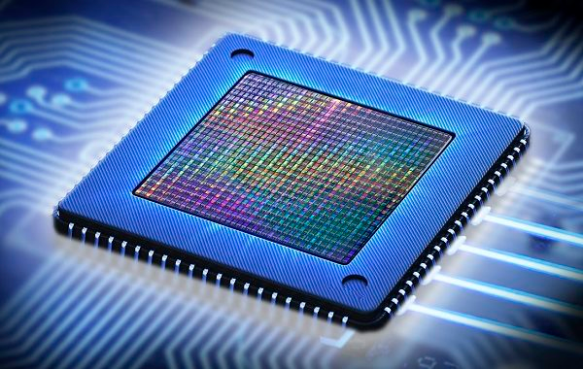
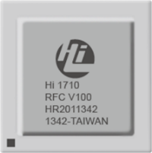

Storage Business
Product Portfolio
Key Technologies
Support Infrastructure
Customer Values
Vision: Defining New Storage
One Data Architecture, and One Management Platform
OceanStor Dorado All Flash
OceanStor Dorado and 100D share one data architecture, which provides Block/File/Object/HDFS/SQL services and enterprise features. Kunpeng and HiSilicon chips provide best performance and TCO.
Unified management platform, with AI-chip assisted optimization and management, with cloud-based AIOps support.
Core business
Production
DR
Backup
Archive
Analytics
OceanStor 100D
Massive amounts of data
Online upgrade
AIOps O&M
Block
File
Object
HDFS
SQL
Plug-and-play
No migration
Always on
Hi1822
Hi1710 BMC
Kunpeng 920 ARM
AI Ascend
Notes:
What is one data architecture?
One data architecture means that new storage products, whether internally SDS or not, satisfy the same set of requirements for data processing. First, different services are fused into one, and can be provided by a single platform. Second, the data architecture can be implemented on different types of platforms (traditional or SDS). Internally, the SDS and traditional array architecture share a lot of architectural designs. Finally, the different platforms can be delivered to market as different products and solutions to meet different needs.
Why using one data architecture? Benefits and values.
Focusing on this core set will better support customer’s future needs. Customers will see a unified set of features for data processing. They can pick and choose OceanStor products based on their needs. Their data will grow with the system, and if needed, seamlessly migrated within the product family.
How is it done?
- The OceanStor series utilize one data architecture and provide both high-performance all-flash storage systems (Dorado) and distributed software defined storage (100D), which serves block, file, and object simultaneously.
- Storage products providing data processing engines that handles structured data (GaussDB) and unstructured data (data lakes). They can be delivered as a solution or as HCI appliances.
Specially designed ARM CPUs and AI accelerator chips will be used widely across the platform to offload computation and provide best performance while lowering the TCO.
- AI assisted operation and management, using AI algorithms for optimization and operation.
- SDS supporting cloud-based infrastructure and meeting data flow requirements using a storage native hybrid cloud strategy.
All system design taking high-availability into account. OceanStor Dorado can function with only one engine running. Overall system reliability is improved via replication across multiple data centers or multiple clouds.
Now let’s talk about the unified management platform. Since the new storage adopts one data architecture, it is natural for it to adopt a unified management platform. This management platform uses the AIOps methodology and cloud based architecture to help customer maintain healthy systems, thereby reducing the overall TCO. The flashever program allows customers to gradually upgrade their system without any data migration.

Slide 13
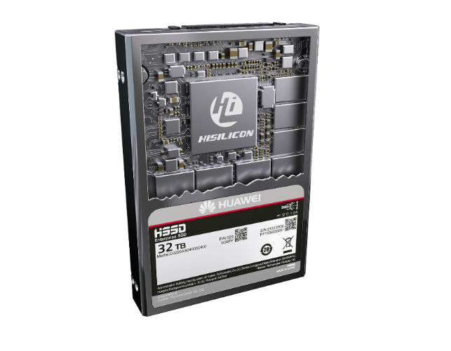





Key storage technologies
Storage Business
Product Portfolio
Key Technologies
Support Infrastructure
Customer Values
Active-active front end
NVMe over fabric
GaussDB
for both OLTP and OLAP
SQL service
Front –end protocols
AI assisted caching technology
Distributed NAS technology
File service
Block service
Hypersnapshot, snapshot technology
Object availability, 3AZ
Object service
Enterprise service
HyperMetro and HyperReplication, Replication and DR technology
Node/engine failover technology for high availability
Node/engine management
Persistent layer
Compression and deduplication
Non-disruptive upgrade
SSD drive technology (controller chip, FTL)
Flashlink technology
Huawei Processors Powered end to end
Elastic Erasure-coding (EC) technology
P P
P P
P P
P P
Network layer
High speed network (RDMA)
Notes:
Here we talk about the key storage technologies. Since there are so many technologies, the presenter can focus on several technologies that the audience is most interested in. Otherwise, the presenter can go through them from top down or bottom up.
There are so many concepts in the storage world, and I don’t expect the listeners to understand them all at once. These concepts will be covered in details later in various training courses. I will use a few examples to show you why they are key storage technologies.
First, let’s talk about Erasure coding (EC).
FlashLink:
Hi-1822 Chip for NVMe over Fabric,
Kunpeng 920 for both Disk Enclosure and System Controller
Hi-1812e for SSD controller
Ascend310 for AI Acceleration

Slide 14
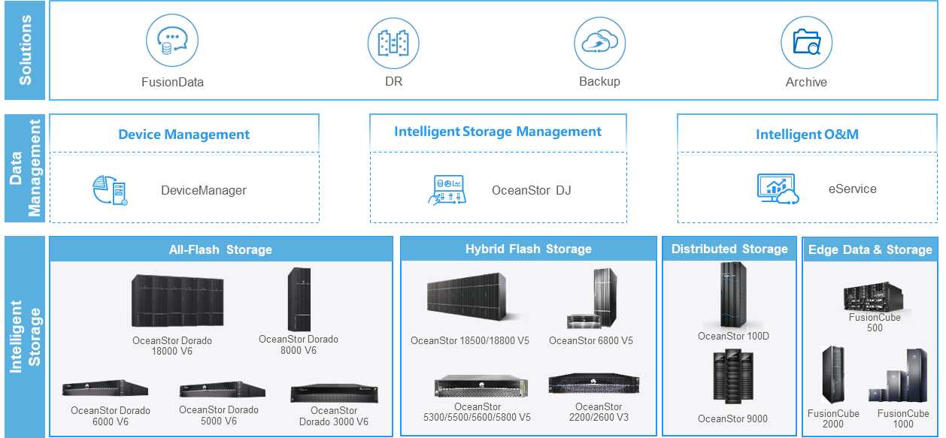
Storage Business
Product Portfolio
Key Technologies
Support Infrastructure
Customer Values
Huawei Intelligent Data Storage Portfolio
Notes:
Huawei Intelligent Data Storage Portfolio offers a wide range of products at three levels: System level, Data Management Level and Solution Level
Key messages:
OceanStor Dorado v6 is industry best AFA product with ultra reliability and scalability for enterprise customers.
OceanStor 100D is our latest big data, data lake solutions with ultra scalability and virtually unlimited scale out throughput.
For Storage system:
OceanStor Dorado v6 is industry best AFA product with ultra reliability and scalability for enterprise customers.
OceanStor Dorado delivers 20 million IOPS for best-in-class performance with Huawei-developed intelligent chips, FlashLink® intelligent algorithm, and end-to-end NVMe design. The next-generation hardware platform and SmartMatrix full-mesh architecture guarantee always-on services with 6 9s. Huawei's AI chips supercharge storage systems to be more intelligent during the application operations, taking the system performance to new heights. Excelling in scenarios such as databases, virtualization, and big data analytics. With new benchmarks in storage performance and reliability, delivering unparalleled data services for critical enterprise applications. Newly introduced NAS capabilities, Dorado can support even broader workload like transactional NAS with excellent scale out and up capabilities as well latency sensitive NAS applications like EDA simulations, ADAS SIL etc. It will become very competitive converged AFA storage product in the future.
OceanStor Dorado 8000/18000 High-End Intelligent All-Flash Storage
A single System support
Up to:
32 controllers
32 TB cache
9,600 enterprise-grade SSDs
OceanStor Dorado 3000/5000/6000 Mid-Range Intelligent All-Flash Storage
Up to:
16 controllers
8 TB cache
1,500 enterprise-grade SSDs
For Hybrid Flash storage product line, Huawei offer OceanStor V5 series with hybrid support and cost effective product without jeopardizing performance and reliability.
OceanStor 6800/18500/18800 Mission-Critical Intelligent Hybrid Flash Storage
Huawei OceanStor 6800/18500/18800 hybrid flash storage has unmatched data services built specifically for critical enterprise applications. It features the industry-leading SmartMatrix 3.0 architecture, integrated SAN and NAS active-active solution, flash optimization technology, efficient hardware platform, and various solutions for improved efficiency and data protection. Consequently, OceanStor 6800/18500/18800 delivers top-of-the-line reliability, performance, and solutions to meet the data storage requirements of applications like large OLTP/OLAP databases and cloud computing. It is an ideal choice for core enterprise applications.
Up to:
32 controllers
32 TB cache
9,600 enterprise-grade disks
OceanStor 5000 Mid-Range Intelligent Hybrid Flash Storage
Huawei OceanStor 5300/5500/5600/5800 hybrid flash storage is for enterprise-grade applications. It features a cloud-ready operating system for storage, powerful next-generation hardware platform, and intelligent management software. It consequently delivers industry-leading reliability, performance, and solutions to meet the data storage requirements of various applications, including medium to large-sized OLTP/OLAP databases and file sharing. It also helps enterprises move their services to the cloud. The OceanStor 5000 series also provides a wide range of efficient and flexible backup and disaster recovery solutions for business continuity and data security, delivering excellent storage services.
Up to:
16 controllers
12 TB cache
2,400 enterprise-grade disks
OceanStor 2200/2600 Mid-Range Intelligent Hybrid Flash Storage
Entry level enterprise storage Customized for multiple applications, various models, and fast business growth through flash-optimized technology and extensive data services.
OceanStor 100D Intelligent Distributed Storage
Our OceanStor 100D is our latest big data, data lake solutions with ultra scalability and virtually unlimited scale out throughput. It is a perfect product for private cloud, hybrid cloud, data lake, big data AI solution.
Huawei FusionStorage is the latest and greatest in-house developed intelligent distributed storage product to provide elastic on-demand services powered by cloud infrastructure, meeting enterprise-grade critical workload requirements. It helps enterprises build a reliable, efficient, and intelligent brand-new storage service platform to help users access large amounts of data on demand in an intelligent world.
Elastic Erasure Coding (EC) data redundancy protection achieves up to 91% disk space utilization
Decoupled compute-storage big data solution, 30% TCO reduction
A stable 0.5 ms latency ensures quick responses to critical workloads
Multi-level reliability assurance delivers six-nines availability
OceanStor 9000 Scale-Out NAS Storage
OceanStor 9000 features a fully symmetric distributed architecture and extensive scale-out capabilities that deliver superior performance and provide a super-large single file system for shared storage of unstructured data. It is ideal for diverse applications and storage resource sharing fields, such as film and TV, satellite mapping, gene sequencing, energy exploration, scientific research, education, video surveillance, as well as backup and archiving.
Kunpeng processors
3 to 288 nodes
Up to 140 PB in capacity
Up to TB/s throughput
Hundreds of billions of pictures can be retrieved within seconds, and Huawei-developed and third-party streaming media software are supported
Edge Data & Storage
FusionCube offers a very solid storage and compute solution for Edge, ROBO scenarios.
Huawei FusionCube 2000 is an IT infrastructure platform for edge data. It integrates computing and storage by using an open architecture with preinstalled distributed storage engines, virtualization, and cloud management software, allowing resources to be allocated on demand and expanded linearly. FusionCube 2000 is perfect for demanding elastic computing, storage, and I/O configuration requirements of Huawei Kunpeng ecosystem services. Its extensive applications configured in a single set of infrastructure make it an ideal choice for deploying IT infrastructure at edge.
Huawei FusionCube 1000 is an integrated solution designed for enterprise branches. It integrates servers, storage devices, switches, firewalls, routers, and uninterruptible power sources. Tailored to the customer, it can be pre-configured and pre-connected for immediate full-container load delivery and plug-and-play installation at the customer's site. In addition, it can be remotely managed with FusionCube Center Vision, making FusionCube 1000 an ideal choice for streamlining information between enterprise branches.
DMS
As number of storage and IT devices are keeping increase in an organization, O&M cost are keep increasing.
Huawei storage data management is divided into 3 layers: device, data center, and cloud categories. They work together for efficient O&M.
At the first layer, DeviceManager simplifies O&M with intelligent device management. One-click service provisioning for faster O&M and lower OPEX. Intelligent capacity prediction (365 days) and on-demand capacity expansion for more precise IT investment. Collection of real-time performance data for intelligent decision-making on the cloud.
OceanStor DJ is an intelligent, converged, and automatic storage management platform that provides full-lifecycle O&M for storage throughout the entire lifecycle, simplifying storage management and improving the operational efficiency at data centers.
Converged: Users can manage storage throughout its lifecycle on one GUI, simplifying multi-device storage management. AI model training on the cloud and real-time model updates ensure more accurate risk and fault prediction.
Automatic: Automatic storage lifecycle management covering planning, construction, O&M, and optimization greatly improves storage resource utilization, troubleshooting rates, and storage management efficiency.
Intelligent: Multi-dimensional intelligent risk prediction and optimization eliminate risks in advance to ensure stable running of production services.
The cloud layer has on and off-premises synergy. Information about a single or multiple devices in a data center are monitored in the cloud. The cloud trains based on its various internal management models. Then it provides intelligent decision-making suggestions back to a local host. Therefore, a single device not only implements simplified O&M based on its own intelligent prediction, it also increases its usability by learning from other advanced sources of information.
The storage equipment and OceanStor DJ report capacity, performance, and alarm information to the eService system. eService performs data cleansing and model training to provide information for intelligent decision-making, such as 365-day capacity predictions and 60-day predictions of performance bottlenecks. Finally, that information is sent back to the local device and OceanStor DJ.
Storage devices then use that information to adopt effective suggestions. The application adjustments are made using intelligent chips, FlashLink algorithms, and DeviceManager capabilities. In addition, our storage devices use eService to utilize learning and management information from other storage devices for intelligent and streamlined O&M.
Solution & Application Level
At solution level, we offer FusionData for big data, AI and big data lake, our DR, Backup and Archiving solutions are very competitive enabled by partnerships with other industry leading vendors.
FusionData Intelligent Data Lake Solution
FusionData is a solution for data fusion and intelligent analysis. FusionData supports intelligent data management throughout the lifecycle. It redefines data infrastructure in access, processing, and enablement so that enterprises undergoing digital transformation can capitalize on data resources as assets.
Disaster Recovery (DR) Solutions
Huawei has established single-, cross-DC DR solutions that feature cutting-edge capabilities running on everything from underlying data to upper-layer applications. The DR solutions fully meet DR system construction needs and offer always-on service continuity for customers across a variety of industries.
Active-passive DR solution: Intra-city or remote DR for rapid service recovery at the DR center in an event of a disaster
Active-active DR solution: Intra-city DR for zero application interruption and zero data loss with two DCs providing services at the same time
Geo-redundant 3DC DR solution: Intra-city active-active DR + remote active-passive DR for a higher level of service continuity with multiple DR copies
Backup Solution
Huawei Backup solutions provide centralized and all-in-one backup. They support backup of databases, file systems, VMs, big data, and email systems. These solutions accelerate your digital transformation by streamlining data backup, lowering TCO, and simplifying data usage.
Efficient: Application I/Os are monitored and backed up in real time with less-than-1-second backup intervals, 300x more frequent than traditional backup.
Cost-efficient: Backup, DR, development, testing, and analytics share data copies to reduce data copy quantity and slash construction costs by over 50%.
Flexible: Direct use of DR data for development and testing reduces data preparation from days to hours and accelerates service rollouts.

Slide 15


Storage Business
Product Portfolio
Key Technologies
Support Infrastructure
Customer Values
Support and Delivery: Global Coverage for 170+ Countries
Technical Assistance Centers (TACs)
3 Global TACs (China, Romania, Mexico)
5 Regional TACs (incl. Malaysia, Cairo)
8 Country TACs (incl. Japan, Russia, Brazil)
Spare Parts Operation Centers (SOCs)
1,000+ Field Stock Locations (FSL)
122+ Country SOCs
6 Regional and Global SOCs
Resource, Logistics & Knowledge Centers
3,000+ Service engineer at 125 offices worldwide
45 Training centers & 80 Authorized Partners
23 R&D sites+ 3 GSRC + 22 RSRC
Poland
Romania
Germany
Russia
Hungary
U.S.A
Turkey
Bahrain
China
Japan
Mexico
Egypt
Thailand
Nigeria
India
Kenya
Malaysia
Indonesia
Technical Assistance centers (TACs )
Regional Spare Parts Operation Centers (RSOCs)
Spare Parts Logistics Centers (SLCs)
Service Resource Centers (SRCs)
R&D centers
Brazil
Notes:
Key Messages:
4-hour response time globally.
Global support and delivery capability for MNC
Consider this as your global IT department
Partner Network: 7,000+ partner service professionals;
Total inhouse and partner 30K+ Service professionals;
GSRC: Global Sustainable Risk Control Center: GSRC is an expert engineering resource center serving Huawei’s Global projects by providing training end-to-end services which sustain and increase the company’s competitive edge in the global market.
TSIA: Technology Service Industry Association, Rated outstanding: Huawei Enterprise, Assisted Support, EMEA
Customer Porsche – HyperMetro Cluster in Russia, Japan, Singapore, China, USA, Brazil, South Korea, France, Italy, UK, Australia & Germany. With eService, alarming communicated via encrypted email to Global TAC in Romania. Hardware monitoring is performed on the ROBO solution in South Korea.

Slide 16


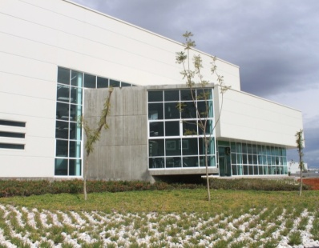
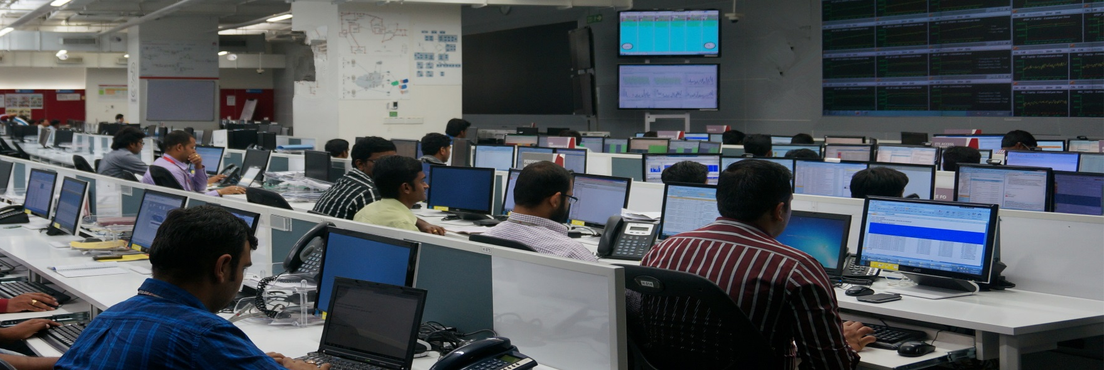
Storage Business
Product Portfolio
Key Technologies
Support Infrastructure
Customer Values
Managed ICT Operations and Services in 60+ Countries
Managing 50+ Projects in Europe, Asia, Africa, Americas
Multi Network/Technology/Vendor service provider
1500+ skilled professionals
Language: English, German, Spanish, Italian, French
30% OPEX decrease for customer
70% less alarm and 24/7 risk monitoring
Certifications: ISO27001, TL9000, ISO20000
Bucharest, Romania
Chengdu, China
Bangalore, India
Queretaro, Mexico
Capability Framework
GNOC Operations
MAI
Solution
Service Desk Mgmt.
Network Surveillance
Performance Mgmt.
Fault Mgmt.
Configuration Mgmt.
Problem Mgmt.
Tools Mgmt.
Security Mgmt.
Tier 2&3 Technical Support
Spare Parts Mgmt.
Network Efficiency & Quality Mgmt.
Work Force Mgmt.
Equipment Capability
Process Analysis
Project Mgmt
Network Capability
Network Alarm
Analysis
Quality Mgmt.
Multi-Language Capability
Performance
Analysis
Cost Mgmt
Centralized ICT Service Delivery Platform
Notes:
Key Messages:
Inherit the capability of GNOC from CT to ICT
Secure and qualified operation model / practices
Diversity of skill set including Server, network, storage and Language.
Knowledge and practice transfer to our customers.
Cost-effective, transparent & best-practice managed infrastructure for highly efficiency & quality ICT services
MAI = Measure, Analyze, Improve ; is a Huawei’s service management methodology
GNOC = Global Network Operation Center
ISO/IEC 27001 is an information security standard, part of the ISO/IEC 27000 family of standards,
ISO 27001 standard has an organizational focus and details requirements against which an organization's Information Security Management System (ISMS) can be audited.
Customer Cases:
PSA - CVMP (Connected Vehicle Modular Platform) – based on Huawei’s IoT Management Platform on the Public Cloud together with PSA and the ISV (Independent SW Vendor).
Senegal & Ivory Coast (France OBS), and Nigeria (MTN, Airtel, 9mobile, all of them are operators; in 9mobile, we do the IT transformation and operation for customer, including the storage)

Slide 17



Storage Business
Product Portfolio
Key Technologies
Support Infrastructure
Customer Values
Core Values to Gain Customer’s Trust
Capability
Openness
Partnership
Reliability &
Performance
-
Competitive Price
-
Global Support
-
Future-Proof
Solutions
ARM ecosystem
-
Open APIs
-
Interoperability
-
Open Source
ICT Extension
-
Integrity
-
Transparency
-
Flexible Business
Model
Notes:
Key messages:
Storage sale is a trust building process.
Emphasize on being a partner than just selling
A company help them to avoid technology lock-in
To gain customer’s trust, which is root of any customer relationships, having a worry-free product is not enough.
We have to offer technologies and solutions to help customer avoid vendor lock-in and also help them gain benefits from the entire ecosystem.
Develop a customer into a partner is critical to gain customer’s trust. We have to act like a partner. We need take care of customer’s needs with integrity and transparency.

Slide 18
Storage Business
Product Portfolio
Key Technologies
Support Infrastructure
Customer Values
Benefits: All-Flash Storage in Any Scenario
Huawei innovations make inclusive all-flash storage cost-effective
HDD
SSD
Computing chip capabilities
25%
Faster
TCO
50%
Latency
2 ms
0.02 ms
Chip
Batch processing latency of AI chips
40%
SmartMatrix architecture capable of tolerating failures of up to 7 out of 8 controllers for always-on services
Power consumption
Maintenance cost
5-year return rate
More reliable
CAPEX
Footprint
13.4%
0.8%
Architecture
30%
82%
79%
50%
Data reduction for higher space utilization
Power consumption
More efficient
10 W
3 W
Huawei AFA vs. HDD storage
Business
Raw capacity
Effective capacity
Notes:
Key messages:
Performance
Innovation
TCO
Let's take a moment to examine all-flash storage in detail. Huawei makes inclusive all-flash storage affordable with innovations in performance, reliability, and power consumption. Specifically speaking:
SSDs perform better than HDDs. HDD latency is at least 2 milliseconds, while SSD latency is 0.02 milliseconds. That means SSD performance is 100 times that of HDDs.
In addition, SSDs are more reliable than HDDs. According to the return rate statistics for the last five years, the return rate of SSDs is only 0.8%, 20 times lower than that of HDDs.
For power consumption, SSDs consume just a third of the power of HDDs. This significantly reduced power consumption lowers the total cost of ownership.
In short, SSDs are faster, more stable, and more efficient.
In the process of upgrading storage for inclusive all-flash storage, Huawei has made many innovations in chips, architecture, and business models to accelerate industrial upgrades to all-flash storage in various scenarios.
We have developed high-performance chips for everything from front-end transmission to computing, including AI, storage, and BMC management chips.
Our SmartMatrix architecture guarantees the stability of storage system services. Our storage systems can tolerate the concurrent failures of seven out of eight controllers, delivering the highest reliability and always-on services.
Finally, our innovative business model for effective capacity simplifies negotiations and brings real economic value to customers.
All-scenario all-flash storage significantly reduces the total cost of ownership by offering customers end-to-end savings in capital expenditure, capacity, power, and maintenance costs.

